Slide 1
Presentation on a research paper:
(An effective privacy Architecture to preserve user Trajectories in Reward-Based LBS Application)
Name : | Niamul Hasan
Semester: | 3.2
Id | 17201026
Section : | A
University of Asia Pacific Department of CSE
CSE 319
Course teacher: Dr. A S M Touhidul Hasan
(Assistant Professor)

Slide 2
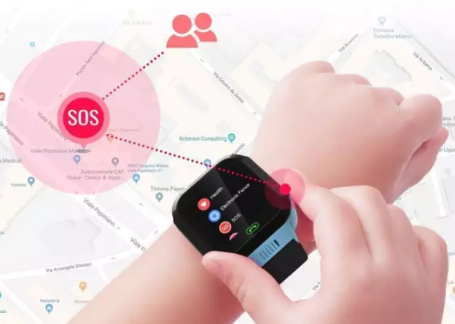
Overview
This paper all about
Reward based LBS Application
Growing use of reward-based LBS application
&
Privacy issue

Slide 3
Introduction: Reward-based LBS applications
location-based service applications
Reward-based

Slide 4
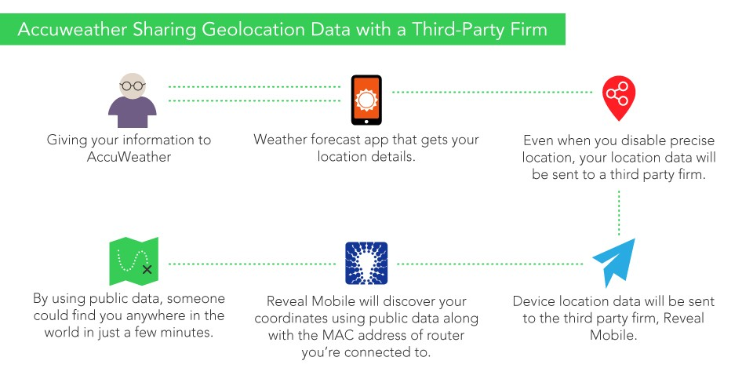
The breach of identified trajectories

Slide 5
Inference and Linking Attacks
Adversary could gain knowledge about mobility frequency.
publicly available data sources to identify the user’s corresponding sensitive information.

Slide 6
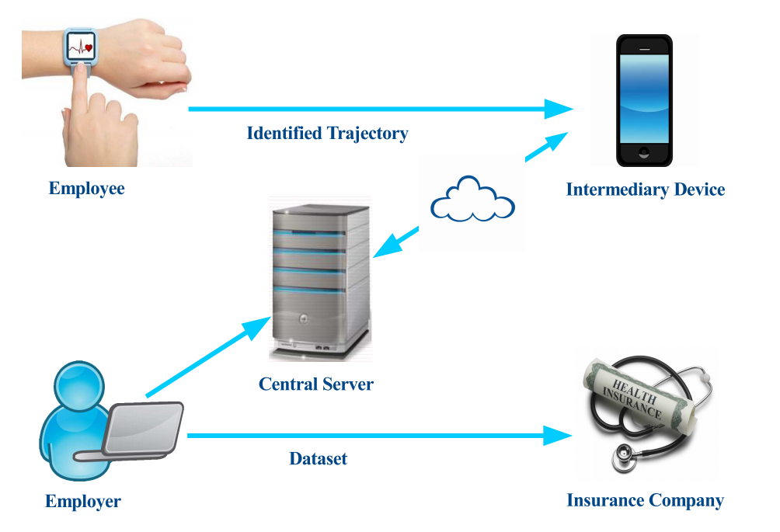
A Client-Server-Based Privacy Methodology
Example: the overview of the proposed client-server privacy architecture.

Slide 7
Anonymization, Bounded Perturbation
1
2
Movement of user u
Identified trajectory
L={id,(x1, y1, t1),(x2, y2, t2), . . . ,(xn, yn, tn)}
< id, (x, y, t)>
visited point at time t
visited point at time t
identity of the user u
identity of the user u

Slide 8
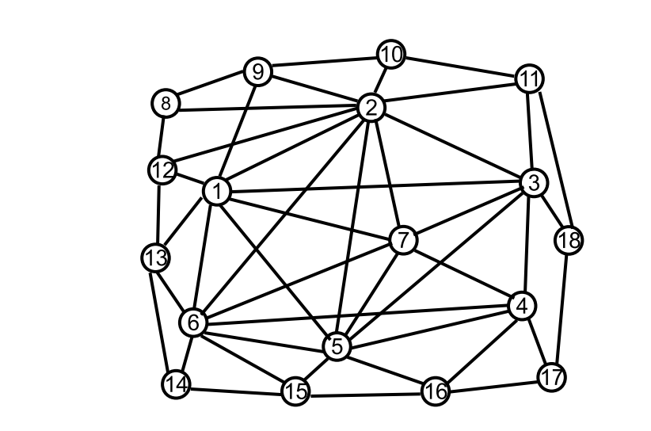
Global location set (GLS)
GLS is generated by using OpenStreetMap API
PoIs
an example of a global location set, where nodes represent the PoIs.
PoIs are connected with each other by a distance d.
Random noise r

Slide 9
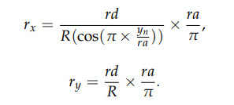

Bounded perturbation
Random noise r
the new PoIs (x’i = xi + rx, y’i = yi + ry)
rx is the random noise for xn and ry is the random noise for yn
So, the random noise rx,ry is
R= Earth’s radius
rd= random distance
ra= random uniform direction
Given an identified trajectory L and applying bounded perturbation technique to generate the anonymized trajectory L’ , represented by

Slide 10
Anonymization Algorithms
2 algorithms to perform anonymization of identified trajectories.
Algorithm 1: Generation of Global Location Set
Algorithm 2: Anonymized Location Trajectory

Slide 11
Experimental Evaluation
The experiments are divided into two parts:
The 1st part was designed to present the personal privacy breach and test the effectiveness of the proposed bounded perturbation algorithm for trajectory anonymization in comparison with the perturbation methods.
In the 2nd part, we measure the effectiveness of bounded perturbation and perturbation techniques in preserving data utility as compared with the original trajectory data

Slide 12
Conclusions and Future Work
Significance of the anonymization of identified trajectories.
The proposed client-server privacy architecture was able to preserve user privacy.
Future work->>

Slide 13
Thank you

